Slide 1


Predictive Modelling for Insurance Claims
Onkabetse Seboea
Workplace Capstone Project

Slide 2
Predictive Modelling for Insurance Claims
Introduction
Problem Statement:
This project aims to predict the total claim amount in insurance claims, focusing on improving the accuracy and efficiency of claims management. By leveraging data from past insurance claims, the project seeks to develop a predictive model that can forecast the total claim amount for new or ongoing claims.
The significance of this project lies in its potential to assist insurers in budgeting, risk assessment, and fraud detection, while also improving customer service by predicting potential claim amounts with greater precision.
The insurance industry is challenged with managing a vast volume of claims, each varying in complexity and cost. Accurate prediction of the total claim amount helps in optimizing resources, setting appropriate reserves, and reducing the risk of overestimating or underestimating claim payouts. The key questions this project addresses include:
What are the primary factors that influence the total claim amount in an insurance claim?
Can machine learning models identify hidden patterns in historical claims data that impact the total claim amount?
How can the prediction model be utilized to improve operational decision-making in the insurance process?

Slide 3
Predictive Modelling for Insurance Claims
Data Collection and Preprocessing steps
The "insurance_claims.csv" dataset is an extensive compilation of insurance claim records. Each entry corresponds to a unique claim, with columns detailing various attributes related to that claim. The dataset emphasizes features such as 'months_as_customer', 'age', policy_number, and more. The primary focus is on the 'total_claim_amount' variable, which which what we aim to predict.
The claims data were gathered from multiple insurance providers, covering a wide range of insurance types, including vehicle, property, and personal injury. Each record offers a detailed view of the claimant's background, specifics of the claim, related documentation, and feedback from insurance experts. Additionally, the dataset includes specific indicators and parameters used during the claim evaluation process, providing a detailed insight into the complexities of each claim.
The dataset consists of 40 columns, and contain a mix of numerical, categorical, and date-related variables.
Some columns, such as umbrella_limit, show extreme ranges, suggesting potential outliers
Missing data: column (_c39) is entirely missing and may need to be dropped. Columns like total_claim_amount, policy_annual_premium, capital-gains, and others have missing values requiring imputation or removal.
Link to the Dataset on Gitlab: https://github.com/Explore-AI/Public-Data/blob/master/insurance_claims.csv

Slide 4
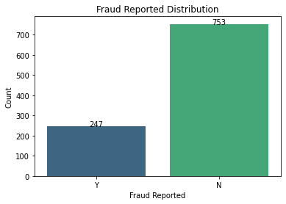
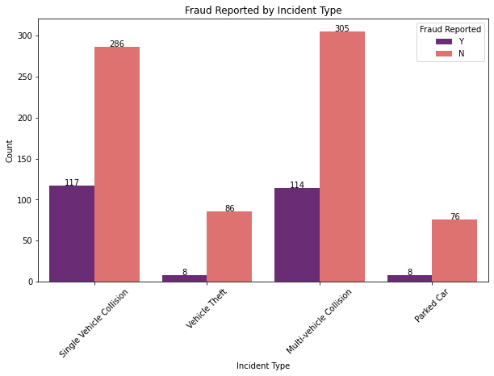
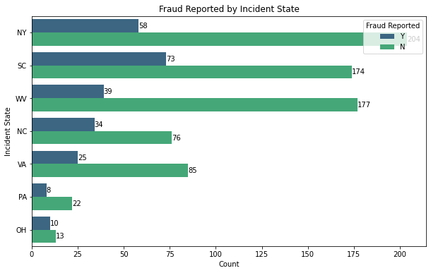
Predictive Modelling for Insurance Claims
Exploratory Data Analysis
The plot shows the proportion of fraud cases, out of the 1000 claims 247 (24,7%) were reported as fraud
This plot shows that South Carolina has the highest fraud reports, followed by New York, then West Virginia
This plot shows that Single Vehicle and Multi-vehicle collisions are more prone to fraud.

Slide 5
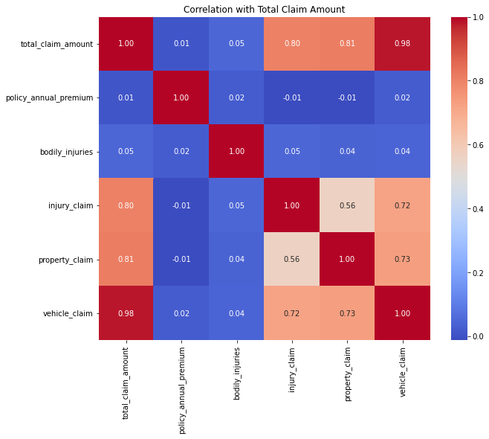
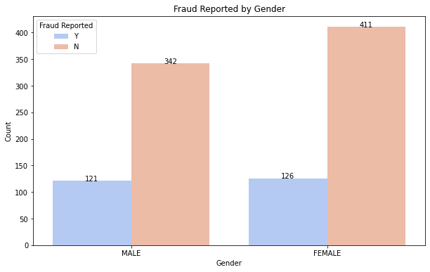
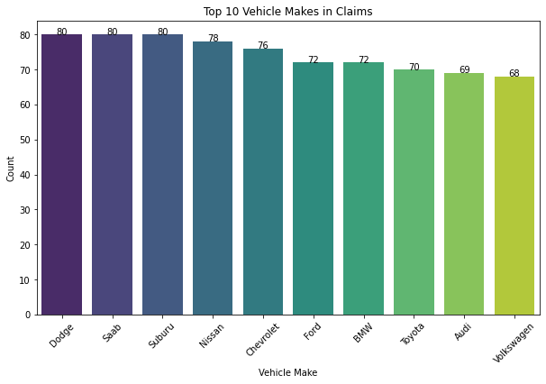
Predictive Modelling for Insurance Claims
Exploratory Data Analysis
By comparing the proportion of fraud reported cases across genders, we can identify if one gender is more frequently associated with claims that result in fraud flags. A higher frequency of fraud cases in one group might prompt further investigation into behavioural or procedural differences.
This plot shows a roughly equal number of claims that are flagged as fraud between males and females.
The bar plot for the top 10 vehicle makes shows which brands are most common among the claimants. This can be influenced by overall market share, but if certain makes are overrepresented in the claims data relative to their market penetration, that may signal a higher risk associated with those vehicles.
This correlation matrix shows that the variables 'vehicle_claim', 'property_claim', and 'injury_claim' have strong correlations with total_claim_amount.

Slide 6
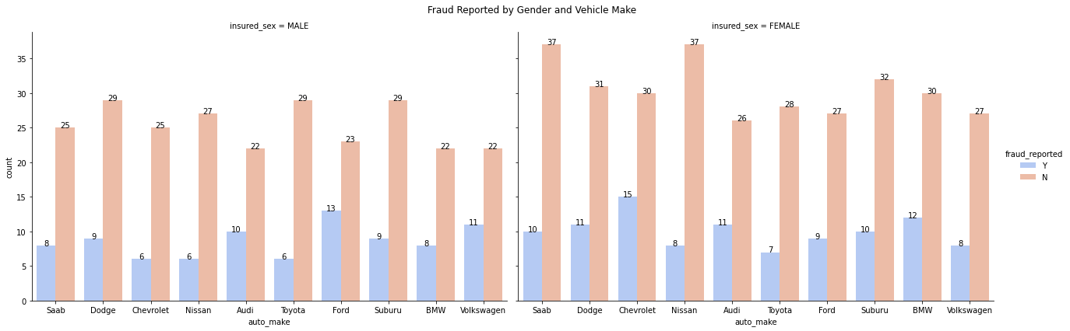
Predictive Modelling for Insurance Claims
Exploratory Data Analysis
The count plot breaking down vehicle makes by gender reveal patterns such as one gender preferring certain vehicle types. If, for instance, females predominantly drive a specific make while males favour another, this information might help in profiling or risk assessment.
A multi-faceted view can highlight if the fraud patterns differ by gender within each vehicle make. For example, you might observe that for a particular auto_make, fraud cases are more common among one gender. Fraud cases are more common on Chevrolet among females and more common on Ford among males.

Slide 7
Predictive Modelling for Insurance Claims
Modelling
Choice of Models: Several models were tested and compared based on their performance:
1. Linear Regression
2. Random Forest Regressor
3. Gradient Boosting Regressor
4. Ridge Regression (L2 Regularization)
GridSearch was applied to tune hyperparameters, and Ridge Regression with an optimal alpha = 0.1 was selected based on validation MSE.
Feature Selection:
Correlation analysis was performed to identify highly correlated features.
Features with high correlation to the target were prioritized.
Redundant and less relevant features were removed.
Feature Engineering:
Handling Missing Values: Imputation techniques were applied where necessary.
Encoding Categorical Variables: One-hot encoding was used for categorical features.
Scaling Numerical Features: StandardScaler was used to normalize continuous variables.

Slide 8
Predictive Modelling for Insurance Claims
Evaluation and Validation
Model | MSE | R2 Score
Linear Regression | 255869739.828 | 0.6541
Random Forest | 228235852.868 | 0.6915
Gradient Boosting Regressor | 227617201.172 | 0.6923
Ridge Regression (L2 Regularization) | 255660947.633 | 0.6544
Gradient Boosting Model was selected as the BEST model because it had the lowest the MSE and Highest R2 score (0.6923)

Slide 9

Thank You

